Slide 1
Java GUI Frameworks
CS 3331
Sections 8.1 & 8.3

Slide 2
Outline
Review: Frameworks
GUI frameworks
MVC
GUI components (widgets)
Layout managers
Handling events
Observer design pattern

Slide 3
What’s a Framework?
A set of cooperating (abstract) classes and interface that:
Represent reusable designs of software systems in a particular application domain,
Provide semi-complete applications that can be specialized to produce custom applications, and
Defines conventions for extending the abstract classes, implementing the interfaces, and allowing their instances to interact with one another
R.E. Johnson, Frameworks = (Components + Patterns), CACM, 4(10):39-42, October 1997.

Slide 4
Why Frameworks?
Main goal: to support reuse of design and implementations in particular application domains
Benefits
Quick and easy application development
Reliable application (i.e., high confidence)
Standardized applications
Q: Any disadvantages?

Slide 5
Characteristics of Frameworks
Extensibility
Inversion of control
Design patterns as building blocks (later topic)
Conventional approach
Framework-based
call
Library
call
<<active>>
Framework
<<active>>
Application
Component
Component
return
…
return
explicit invocation
(HW1: Main -> ConsoleUI)
implicit invocation
(HW3+: UI event handlers <- GUI)

Slide 6
Examples
Small frameworks
Applet, NoApplet, AnimationApplet, DBAnimationApplet, etc.
GUI frameworks
AWT/Swing, Eclipse SWT (Standard Widget Toolkit)
Android UI framework, iOS frameworks
MFC
Distributed programming frameworks
RMI
J2EE

Slide 7
Frameworks To Be Discussed
GUI frameworks (AWT and Swing)
Collection classes
Input and output classes

Slide 8
GUI Frameworks In General
Model-View-Control (MVC) metaphor
Event-based, implicit invocation style
<-> Explicit invocation style
Single thread-ness
Framework classes
GUI components (views or widgets)
Layout managers
Events and event listeners
Graphics and imaging classes

Slide 9
Model-View-Controller (MVC)
A way of cleanly breaking an application into three parts
Model for maintaining data,
View for displaying all or a portion of the data, and
Controller for handling events that affect the model or views.
View
(UI element)
update UI
notify user action
Control
update data
notify change
Model
(data)

Slide 10
Key: Separating M from VC
get data
from model
changes
model or view
View
Controller
Model
update view
when data changes

Slide 11
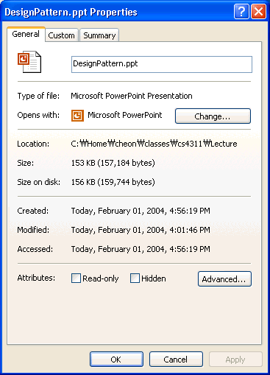
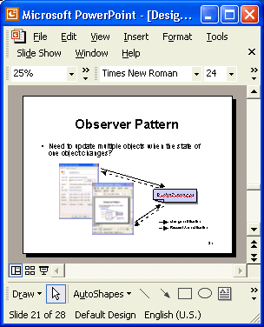
Due to Separation …
Multiple views and controllers for models
model
gui.ppt
views
request & modification
change notification

Slide 12
Due to Separation … (Cont.)
New views and controllers can be added for the model.
Changes in views are localized; such changes have minimal or no impact on the model.

Slide 13
Outline
Frameworks
GUI framework
MVC
GUI components (widgets)
Layout managers
Handling events
Observer pattern

Slide 14
Java GUI Frameworks
GUI frameworks
Part of Java Foundation Class (JFC)
Abstract Window Toolkit (AWT) and Swing
Framework classes
GUI components (or widgets)
Layout managers
Events and event listeners
Graphics and imaging classes

Slide 15
AWT vs. Swing
AWT
Heavyweight components
Associated with native components called peers
Same behaviour, but platform-dependent look
Package java.awt
Swing
Lightweight components, i.e., no peer components
Same look and feel across platforms
Support pluggable look and feel
Package javax.swing

Slide 16
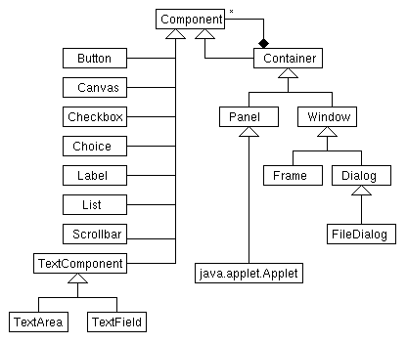
AWT Components
primitive
container

Slide 17
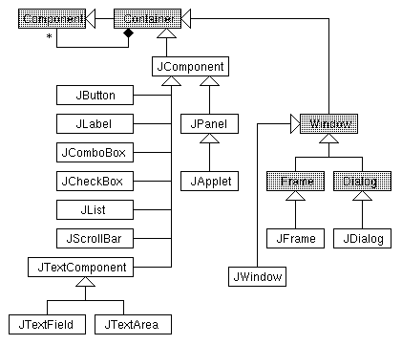
Swing Components
Every widget is a container!

Slide 18
Composite Design Pattern
To allow clients to treat both single components and collections of components identically
To define recursive data structures such as trees
uses
*
Client
Component
operation()
Leaf
operation()
Composite
operation()
add(Component)
remove(Component)

Slide 19
Outline
Frameworks
GUI framework
MVC
GUI components (widgets)
Layout managers
Handling events
Observer pattern

Slide 20
Q: How to Layout Widgets?
Three approaches
Manually specify absolute positions
Manually specify relative positions
Automate it
What’re pros and cons?

Slide 21
Layout Managers
Associated with containers
Automate the layout of elements
When elements are added to the container
When the window is resized
automatically adjust the positions and sizes of the elements.

Slide 22
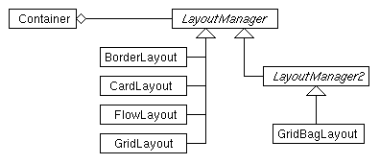
Hierarchy of Layout Managers

Slide 23
Using Layout Managers
Method Description
setLayout(lm) Set lm as the layout manager
add(comp) Add a component
add(comp, cst) Add a component with constraint

Slide 24
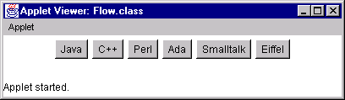
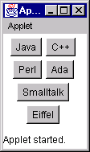
Flow Layout
width=400 height=50
width=100 height=120

Slide 25
Flow Layout (Cont.)
public class Flow extends Applet {
public Flow () {
setLayout(new FlowLayout());
add(new JButton("Java"));
add(new JButton("C++"));
add(new JButton("Perl"));
add(new JButton("Ada"));
add(new JButton("Smalltalk"));
add(new JButton("Eiffel"));
}
}

Slide 26
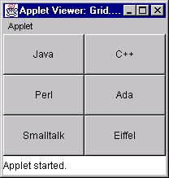
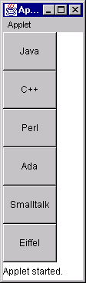
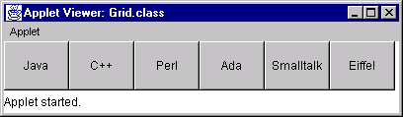
Grid Layout
3x2 grid
0x1 grid
1x0 grid

Slide 27
Grid Layout (Cont.)
public class Grid extends Applet {
public void init () {
int row = 0;
int col = 0;
String att = getParameter("row");
if (att != null) {
row = Integer.parseInt(att);
}
att = getParameter("col");
if (att != null) {
col = Integer.parseInt(att);
}
if (row == 0 && col == 0) {
row = 3; col = 2;
}
setLayout(new GridLayout(row, col));
add(new JButton("Java"));
add(new JButton("C++"));
add(new JButton("Perl"));
add(new JButton("Ada"));
add(new JButton("Smalltalk"));
add(new JButton("Eiffel"));
}
}

Slide 28
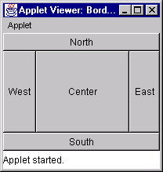
Border Layout

Slide 29
Border Layout (Cont.)
public class Border extends Applet {
public Border () {
setLayout(new BorderLayout());
add(new JButton("North"), BorderLayout.NORTH);
add(new JButton("South"), BorderLayout.SOUTH);
add(new JButton("East"), BorderLayout.EAST);
add(new JButton("West"), BorderLayout.WEST);
add(new JButton("Center"), BorderLayout.CENTER);
}
}

Slide 30
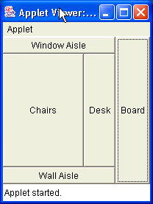
Exercise
Write an applet of the following layout.
public class ClassRoom extends Applet {
public ClassRoom () {
setLayout(new BorderLayout());
// WRITE YOUR CODE HERE…
}
}

Slide 31
Outline
Frameworks
GUI framework
MVC
GUI components (widgets)
Layout managers
Handling events
Observer pattern

Slide 32
Event Handling
Mechanism to write control code
Composed of:
Event
Event source
Event listener (or handler)

Slide 33
Event Handling (Cont.)
Event
A way for GUI components to communicate with the rest of application
Implemented as event classes (e.g., ActionEvent)
Event source
Components generating events
Examples: buttons, check boxes, combo boxes, etc.

Slide 34
Event Handling (Cont.)
Event listener (or handler)
Objects that receives and processes events
Must implement an appropriate listener interface
Must inform the source its interest in handling a certain type of events (by registering)
May listen to several sources and different types of events

Slide 35
Example
<<interface>>
ActionListener
actionPerformed(ActionEvent)
// create a button
JButton button = new JButton(“Increment”);
// register an action listener
button.addActionListener(new ButtonActionListener());
// Action listener class
class ButtonActionListener implements ActionListener {
public void actionPerformed(ActionEvent e) {
// handle the event e …
System.out.println(“Increment button pressed!”);
}
}

Slide 36
How Does It Work?
b: JButton
h: ActionListener
addActionListener(h)
<<create>>
e: ActionEvent
actionPerformed(e)
getSource()
Notes:
Observer design pattern

Slide 37
Naming Convention
For event XYZ …
Event class: XYZEvent
Listener interface: XYZListener
Adapter class: XYZAdapter
Registration method: addXYZListener()

Slide 38
Events and Listeners
Event Listener Adapter
ActionEvent ActionListener
ComponentEvent ComponentListener ComponentAdapter
FocusEvent FocusListener FocusAdapter
KeyEvent KeyListener KeyAdapter
MouseEvent MouseListener MouseAdapter
MouseMotionListener MouseMotionAdapter
WindowEvent WindowListener WindowAdapter
ItemEvent ItemListener
TextEvent TextListener
…
ComponentEvent: component’s changes of size, location, and visibility
FocusEvent: component’s gain/loss of keyboard focus
KeyEvent: keystrokes
MouseEvent: mouse press, release, click, enter and exit; mouse motion (e.g., dragging and moving)
WindowEvent: opened, closed, activated or deactivated, iconified or deiconified.
ItemEvent: item selection, etc.

Slide 39
Example: Resizing Component
To prevent windows from being resized too small, use ComponentEvent and ComponentListener
public class Main extends JFrame {
public Main(String name) {
super(name);
// ….
setResizable(true);
addComponentListener(new MyComponentListener(400, 300));
}
// definition of MyComponentListener class (see the next slide)
// …
}

Slide 40
Example (Cont.)
private static class MyComponentListener extends ComponentAdapter {
private int width, height;
public MyComponentListener(int width, int height) {
this.width = width; this.height = height;
}
public void componentResized(ComponentEvent e) {
Component c = e.getComponent();
if (c.getWidth() < width || c.getHeight() < height) {
c.setSize(Math.max(width, c.getWidth()),
Math.max(height, c.getHeight()));
}
}
}

Slide 41
Exercise
Write handler code to print a goodbye message to System.out when the main window is closed.
Hint: The WindowListener interface defines, among others, the method “void windowClosing(WindowEvent)”.
public class Main extends JFrame {
public Main(String name) {
// WRITE YOUR CODE HERE
}
}

Slide 42

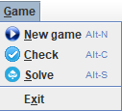
HW4: Menu And Action Bar
Provide a menu and a tool bar for: new, check and solve.
Hints:
Use setJMenuBar(JMenuBar) of JFrame
Use BorderLayout and add a JToolBar to the NORTH, e.g.,
add(createToolBar(), BorderLayout.NORTH).

Slide 43
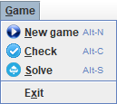
Side: JMenuBar
menu bar
menu
menu item
JMenuBar menuBar = new JMenuBar();
JMenu menu = new JMenu("Game");
menu.setMnemonic(KeyEvent.VK_G);
menu.getAccessibleContext().setAccessibleDescription("Game menu");
menuBar.add(menu);
JMenuItem menuItem = new JMenuItem("New game", KeyEvent.VK_N);
menuItem.setIcon(…));
menuItem.setAccelerator(KeyStroke.getKeyStroke(
KeyEvent.VK_N, ActionEvent.ALT_MASK));
menuItem.getAccessibleContext().setAccessibleDescription(
"Play a new game");
menuItem.addActionListener(…);
menu.add(menuItem);
…

Slide 44

Side: JToolBar
button
tool bar
tool tip
JToolBar toolBar = new JToolBar("Sudoku");
JButton button = new JButton(createImageIcon("play.png"));
button.addActionListener(…);
button.setToolTipText("Play a new game");
button.setFocusPainted(false);
toolBar.add(button);
…
/** Create an image icon from the given image file. */
private ImageIcon createImageIcon(String filename) {
URL imageUrl = getClass().getResource(IMAGE_DIR + filename);
if (imageUrl != null) {
return new ImageIcon(imageUrl);
}
return null;
}

Slide 45
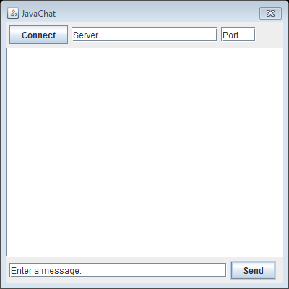
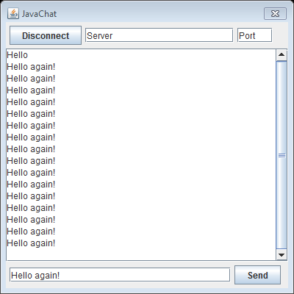
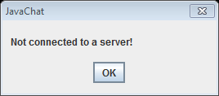
Exercise: JavaChat
Create UI of JavaChat dialog (sample screens below); dialog template available from course website.
Upon the Send button click when not connected (left) and connected (right)
UI components: JButton, JTextField, JTextArea, JScrollPane

Slide 46
Outline
Frameworks
GUI framework
MVC
GUI components (widgets)
Layout managers
Handling events
Observer pattern

Slide 47
A Closer Look at JButton
How the button events (e.g., clicking) are handled?
JButton button = new JButton(“Ok”);
button.addActionListener(new OkButtonListener());
…
private class OkButtonListener implements ActionListener {
public void actionPerformed(ActionEvent e) {
System.out.println(“Ok button pressed!”);
}
}

Slide 48
Static Structure
Q: Why use interface?
*
listeners
<<interface>>
ActionListener
actionPerformed()
JButton
addActionListener()
removeActionListener()
fireActionPerformed()
OkButtonListener
actionPerformed()
for each l in listeners
l.actionPerformed(e);

Slide 49
Dynamic Behavior
button : JButton
l : OkButtonListener
addActionListener(l)
<<create>>
e : ActionEvent
fireActionPerformed(e)
actionPerformed(e)
getSource()

Slide 50
Observer Pattern
Intent
To define relationship between a group of objects such that whenever one object is updated all others are notified automatically.
Context
Multiple objects depend on the state of one object.
Set of dependent objects may change at runtime.
Solution
Allow dependent objects to register with object of interest, and notify them of updates when state changes.

Slide 51
Structure
Subject
observers
Observer
attach(Observer)
detach(Observer)
0..*
update()
notifyChange()
public void notifyChange() {
public void update() {
for each o in observers
... subject.getState() ...
o.update();
}
}
ConcreteSubject
ConcreteObserver
subject
getState()
update()
setState()
ConcreteObserver may depend on ConcreteSubject,
but not the other way around!

Slide 52
Participants
Subject
Knows its observers
Provides interface for attaching and detaching observers
Observer
Defines an updating interface
ConcreteSubject
Stores state of interest
Sends notification to observers on state change
ConcreteObserver
Maintains a reference to a concrete subject.
Stores state that should stay consistent with the subject’s.
Implements the updating interface to keep its state consitent with the subject’s.

Slide 53
Collaborations
s : ConcreteSubject
o1 : ConcreteObserver
o2 : ConcreteObserver
attach(o1)
setState()
attch(o2)
notifyChange()
update()
getState()
update()
getState()
detach(o1)
detach(o2)

Slide 54
Exercise
Make the following class observable.
public class Suspect {
public void meetWith(Person p) { /* … */ }
}

Slide 55
(Pair) Exercise
Make the Connect Five Board class observable (when its state is changed), e.g., a new disc is placed, or there is a winner, etc.
/** Listen to board changes. */
public interface BoardChangeListener {
/** Called when a number is placed on a square. */
void discPlaced(Disc disc, int x, int y);
/** Called when there is a winner. */
void thereIsWinner();
…
}

